Slide 1

Project 2
Chicago Traffic Crashes Analysis
By Smit Rana

Slide 2
Problem Statement
This project aims to conduct a comprehensive analysis of Chicago traffic incidents using Power BI and DAX, leveraging a dataset containing detailed information about crashes. The dataset includes various attributes such as crash date, speed limits, weather conditions, and injuries sustained.
The goal is to visualize and analyze traffic patterns, identify contributing factors to accidents, and provide actionable insights for enhancing road safety and traffic management in Chicago.

Slide 3
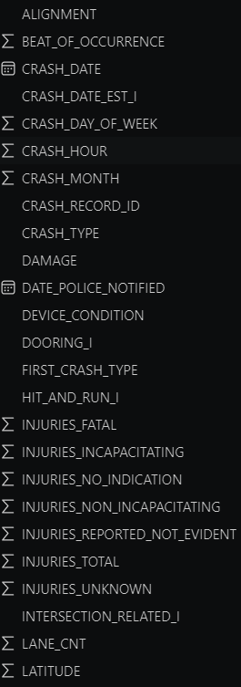
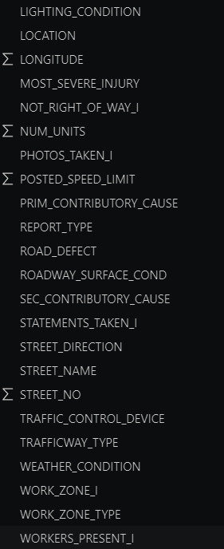



About Data
The dataset comprises 794,956 records with 48 attributes. Among these attributes, some columns exhibit more than half of their values as missing data. Consequently, these columns are discarded since it would not be meaningful to impute values for such a large portion of missing data.
For columns with a moderate number of missing values, we filter out these records.
However, for columns with very few missing values, we opt to impute the missing values by utilizing the prior value of the respective cell.
For further analysis, I created additional columns using DAX

Slide 4
Integration Enhancement
In addition to the prescribed project requirements, I undertook an integration enhancement by incorporating Microsoft Azure to connect Power BI for analysis.
Approach :
Data Ingestion: Traffic crash data was imported into Azure SQL Database from various sources, ensuring data quality and consistency.
Connection: Power BI was connected directly to Azure SQL Database, enabling real-time access to the data.
Modeling: Within Power BI, data was modeled for analysis, including transform the raw data into a structured and optimized format that is well-suited for analysis and relationship definition
Dashboard Design: Interactive dashboards and visualizations were created in Power BI to explore traffic crash trends.
Refresh: Regular data refreshes were configured in Power BI to ensure up-to-date analysis.

Slide 5
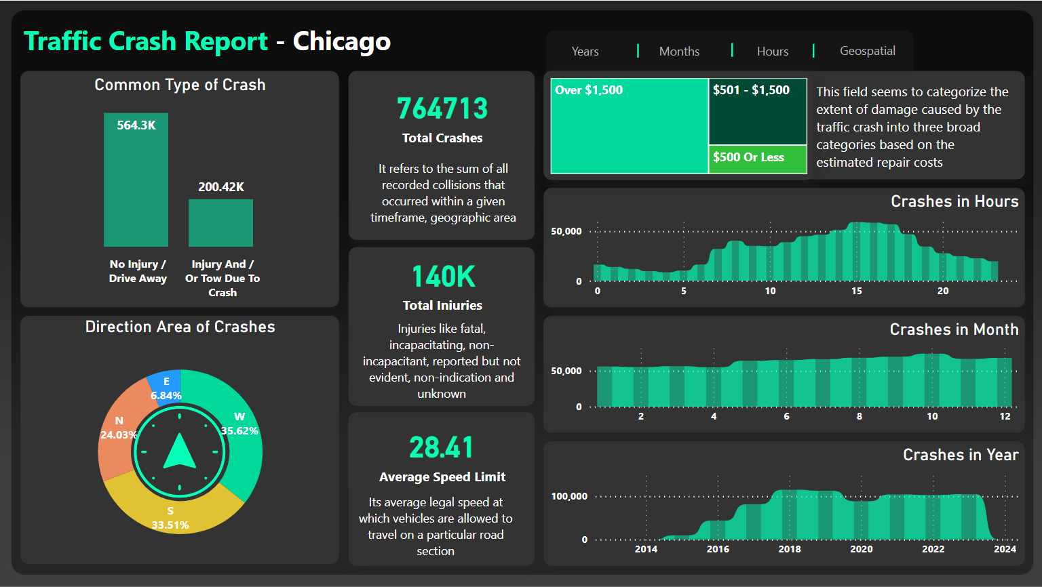

Slide 6
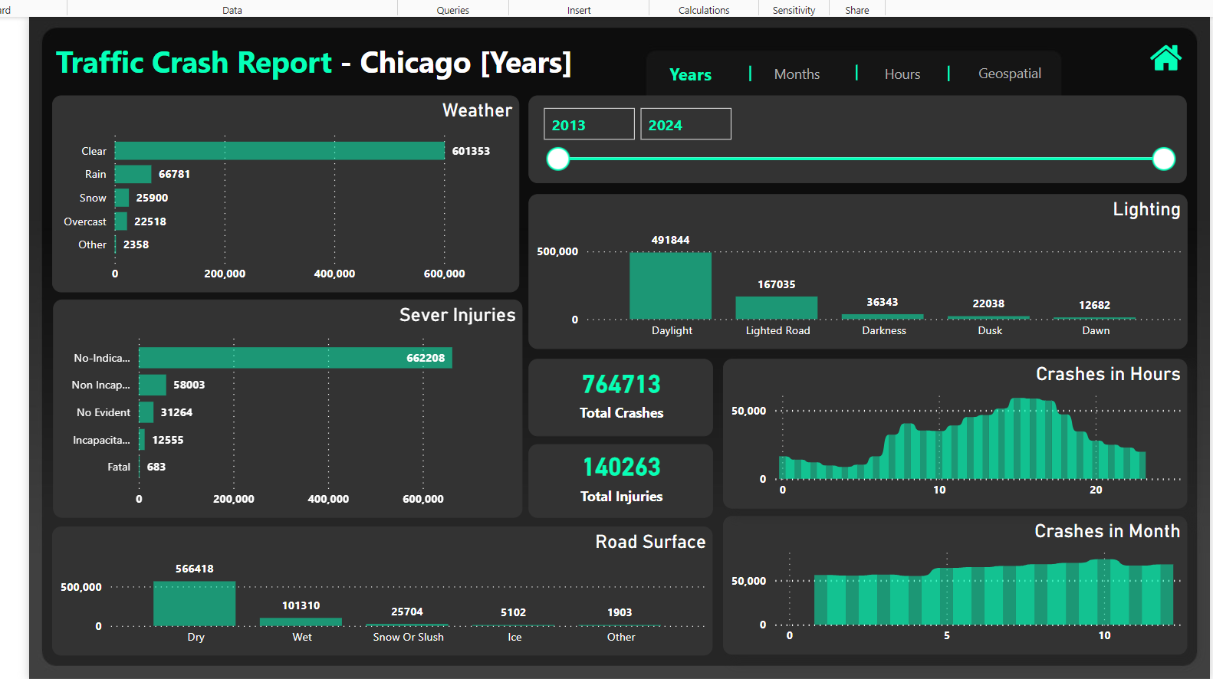

Slide 7
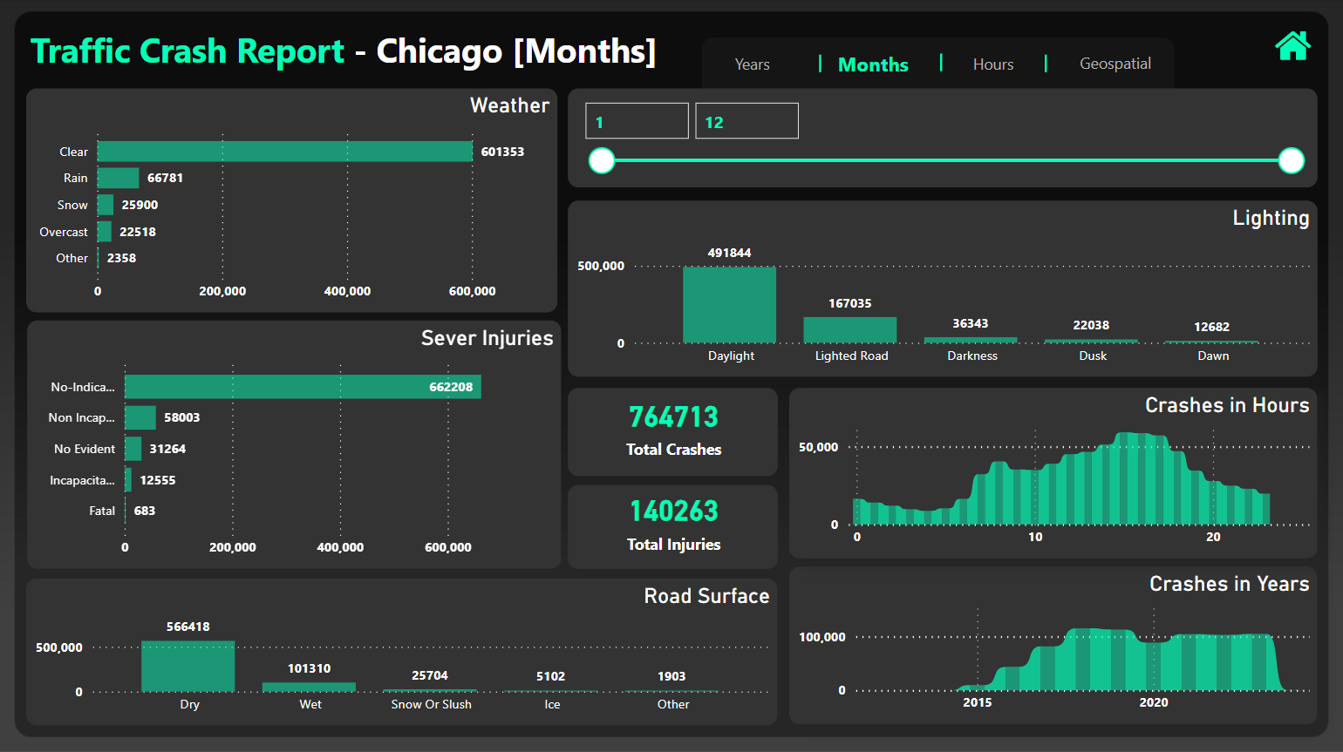

Slide 8
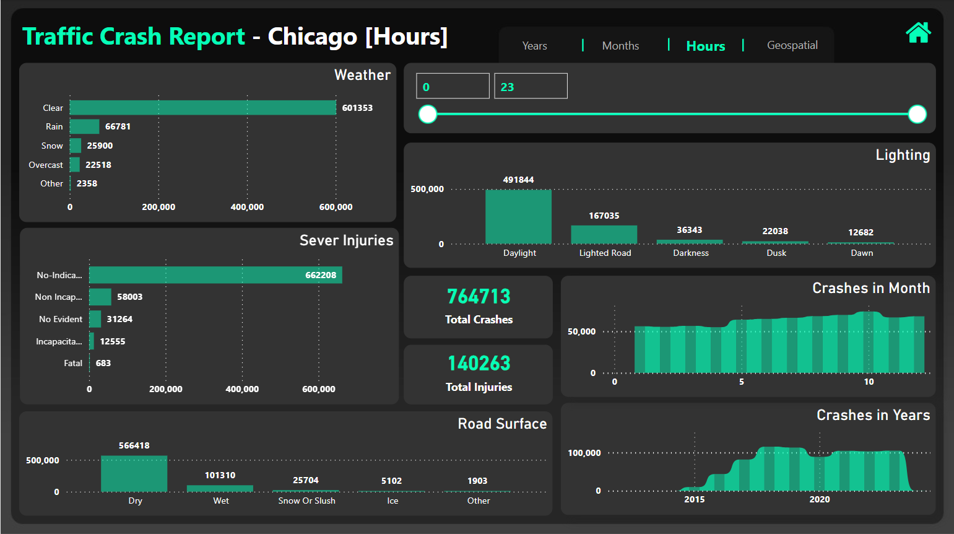

Slide 9
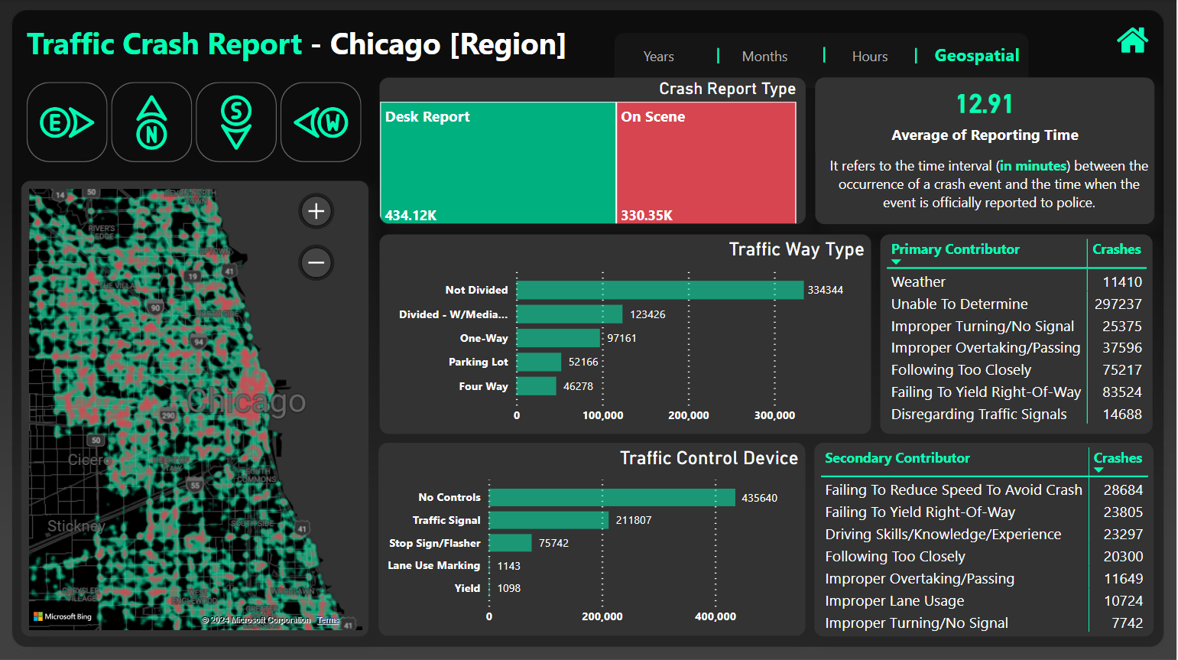

Slide 10
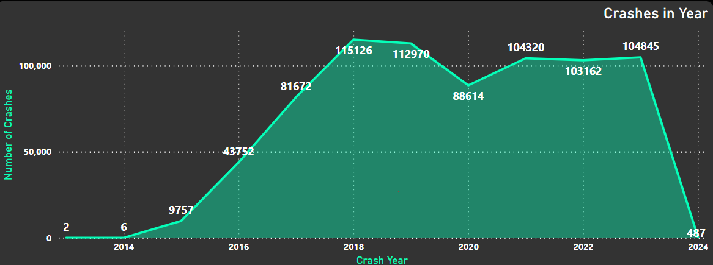
Traffic Crashes between 2014 - 2024
The data reveals a notable pattern in traffic crashes over the years. Starting from 2014, there is a significant exponential increase, reaching its peak in 2015.
Subsequently, the trend stabilizes somewhat until 2019. However, a decline is observed thereafter, coinciding with the onset of the global pandemic, which impacted countries worldwide. The trend shifts once more in 2021, showing a rise, and it remains relatively stable throughout 2023.

Slide 11
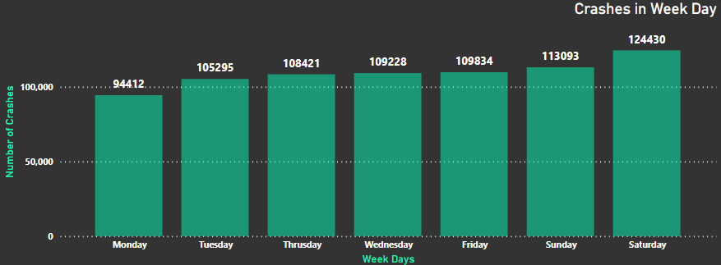
Traffic Crashes in Weekdays
It's evident that the majority of crashes occur on Fridays, Saturdays and Sundays. This trend could be attributed to increased social activities and higher road usage during weekends, such as parties and gatherings.
It's possible that these weekend days also witness a rise in alcohol consumption, particularly post-midnight, which could contribute to the heightened risk of accidents.

Slide 12
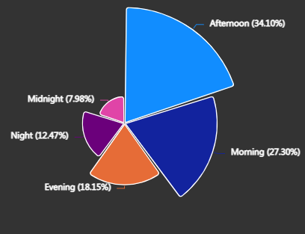
Collisions in Different Segments of Time
This rose pie plot visualizes the distribution of crashes according to different times of the day. It's evident that a significant portion of the crashes happens during the afternoon. This aligns with the observation from subsequent graphs below, indicating that most major crashes occur during daylight and clear weather conditions. Conversely, the fewest crashes occur at midnight, possibly because fewer people are driving during that time period.
TIME_OF_DAY =
SWITCH(
TRUE(),
HOUR('Traffic_Crashes_-_Crashes'[CRASH_DATE]) >= 5 && HOUR('Traffic_Crashes_-_Crashes'[CRASH_DATE]) < 12, "Morning",
HOUR('Traffic_Crashes_-_Crashes'[CRASH_DATE]) >= 12 && HOUR('Traffic_Crashes_-_Crashes'[CRASH_DATE]) < 17, "Afternoon",
HOUR('Traffic_Crashes_-_Crashes'[CRASH_DATE]) >= 17 && HOUR('Traffic_Crashes_-_Crashes'[CRASH_DATE]) < 20, "Evening",
HOUR('Traffic_Crashes_-_Crashes'[CRASH_DATE]) >= 20 && HOUR('Traffic_Crashes_-_Crashes'[CRASH_DATE]) < 24, "Night",
HOUR('Traffic_Crashes_-_Crashes'[CRASH_DATE]) >= 0 && HOUR('Traffic_Crashes_-_Crashes'[CRASH_DATE]) < 5, "Midnight",
"Unknown"
)

Slide 13
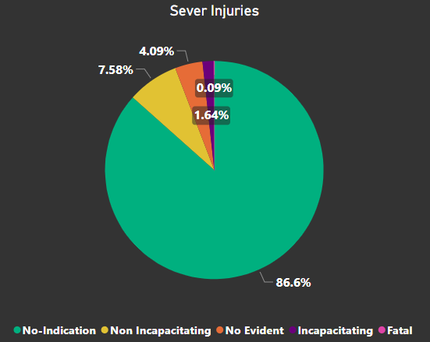
Severe Injuries happened in Traffic Crashes
The data indicates that the vast majority, or 86%, of reported traffic crashes show no indication of injuries. Fatal injuries are exceedingly rare, accounting for only 0.09% of all crashes. However, there is a notable portion, 1.6%, of individuals who reported injuries, yet there is no evident sign of those injuries.
In the context of injuries, a non-incapacitating injury refers to harm sustained by an individual that does not significantly impair their ability to carry out normal daily activities. On the other hand, an incapacitating injury is more severe, rendering the individual unable to perform regular tasks, including work or other routine functions, for a certain duration.

Slide 14
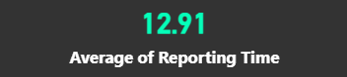
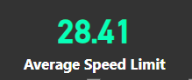
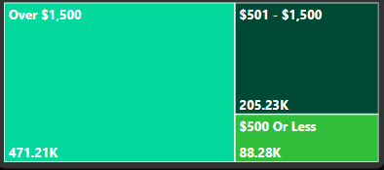
It refers to the time interval (in minutes) between the occurrence of a crash event and the time when the event is officially reported to police.
Reporting Time =
IF(
MINUTE('Traffic_Crashes_-_Crashes'[DATE_POLICE_NOTIFIED]) >= MINUTE('Traffic_Crashes_-_Crashes'[CRASH_DATE]),
MINUTE('Traffic_Crashes_-_Crashes'[DATE_POLICE_NOTIFIED]) - MINUTE('Traffic_Crashes_-_Crashes'[CRASH_DATE]),
BLANK()
)
Its average legal speed at which vehicles are allowed to travel on a particular road section
It appears that this field categorizes the extent of damage caused by traffic crashes into three main categories based on estimated repair costs.
The majority of crashes involve damage exceeding $1500 to vehicles, followed by damage ranging between $501 and $1500. There are notably fewer crashes involving damage amounting to less than $500.

Slide 15
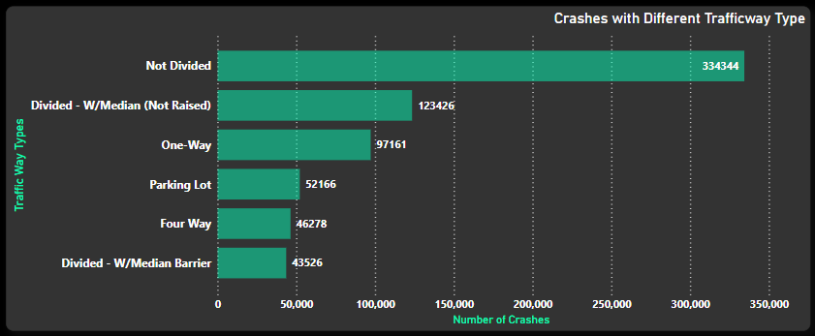
Crashes with Trafficways
The data indicates that undivided traffic ways experience notably higher crash rates due to the absence of physical barriers. On such roads, vehicles traveling in opposite directions share lanes, heightening the risk of accidents during passing or overtaking maneuvers.
In contrast, divided roads with a median (not raised) demonstrate lower crash frequencies as drivers are aware of the clear separation for passing vehicles. Furthermore, roads featuring a median barrier exhibit the lowest crash rates compared to other traffic way types, underscoring the effectiveness of physical barriers in minimizing accidents.

Slide 16
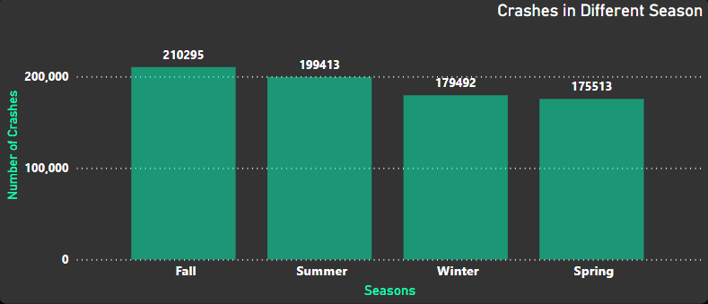
Traffic Crashes in Different Seasons
Based on the visualization provided, it appears that the highest number of crashes takes place during the fall and summer seasons. Conversely, the lowest number of crashes is observed during the spring season.
Season =
SWITCH (
TRUE (),
MONTH ( 'Traffic_Crashes_-_Crashes'[CRASH_DATE] ) IN {12, 1, 2}, "Winter",
MONTH ( 'Traffic_Crashes_-_Crashes'[CRASH_DATE] ) IN {3, 4, 5}, "Spring",
MONTH ( 'Traffic_Crashes_-_Crashes'[CRASH_DATE] ) IN {6, 7, 8}, "Summer",
MONTH ( 'Traffic_Crashes_-_Crashes'[CRASH_DATE] ) IN {9, 10, 11}, "Fall",
"Unknown"
)

Slide 17
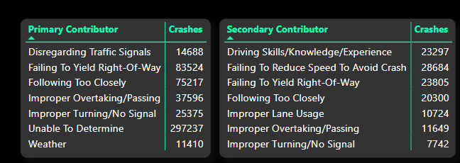
Contributors of Crahses
The analysis identifies primary and secondary factors contributing to crashes. "Unable To Determine" indicates a lack of clarity on the primary cause. Additionally, "Failing To Yield Right-Of-Way" and "Following Too Closely" are significant primary contributors. Weather conditions also play a role. Among secondary contributors, "Failing To Reduce Speed To Avoid Crash" is notable. "Improper Turning/No Signal" is prominent in both categories, emphasizing the importance of signaling while turning. Other factors include improper overtaking/passing, disregarding traffic signals, improper lane usage, and driving skills/knowledge/experience.
the most common contributors to crashes are failing to yield right-of-way, following too closely, and improper turning or lack of signaling. Addressing these issues could greatly improve road safety and reduce the frequency of accidents.

Slide 18
Geospatial Analysis
import pandas as pd
import folium
from folium import plugins
traffic_crash = pd.read_csv('traffic_crash.csv', low_memory=False)
traffic_crash.dropna(subset=['LATITUDE', 'LONGITUDE'], inplace=True)
# Create a map centered on Chicago.
m = folium.Map(location=[41.8781, -87.6798], zoom_start=12)
hitrun = plugins.MarkerCluster().add_to(m)
for lat, lng in zip(traffic_crash['LATITUDE'], traffic_crash['LONGITUDE']):
folium.Marker(
location=[lat, lng],
icon=None,
).add_to(hitrun)
# Display the map.
m

Slide 19
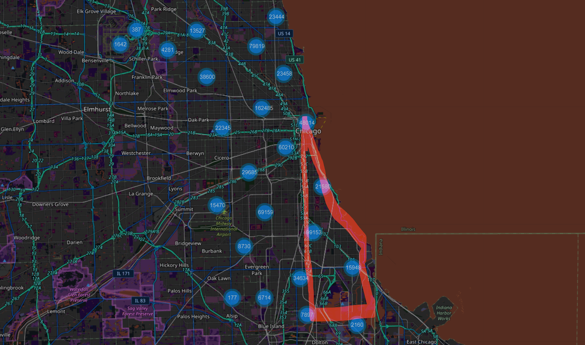
EAST
[6.84%]

Slide 20
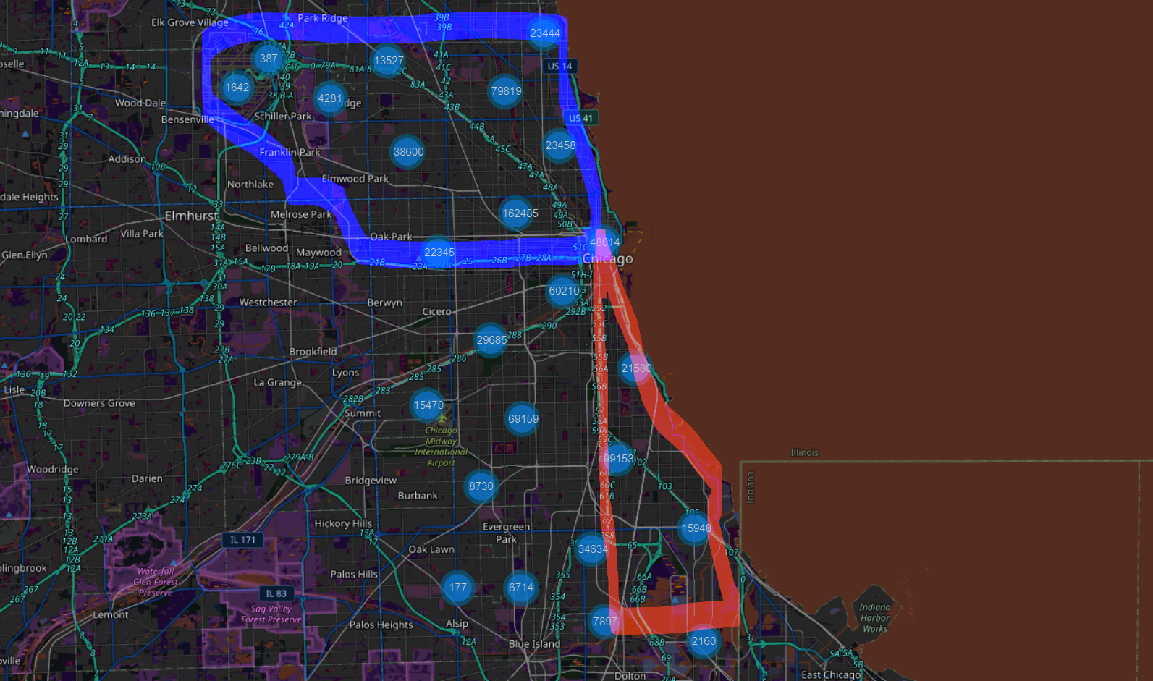
NORTH
[24.03%]
EAST
[6.84%]

Slide 21
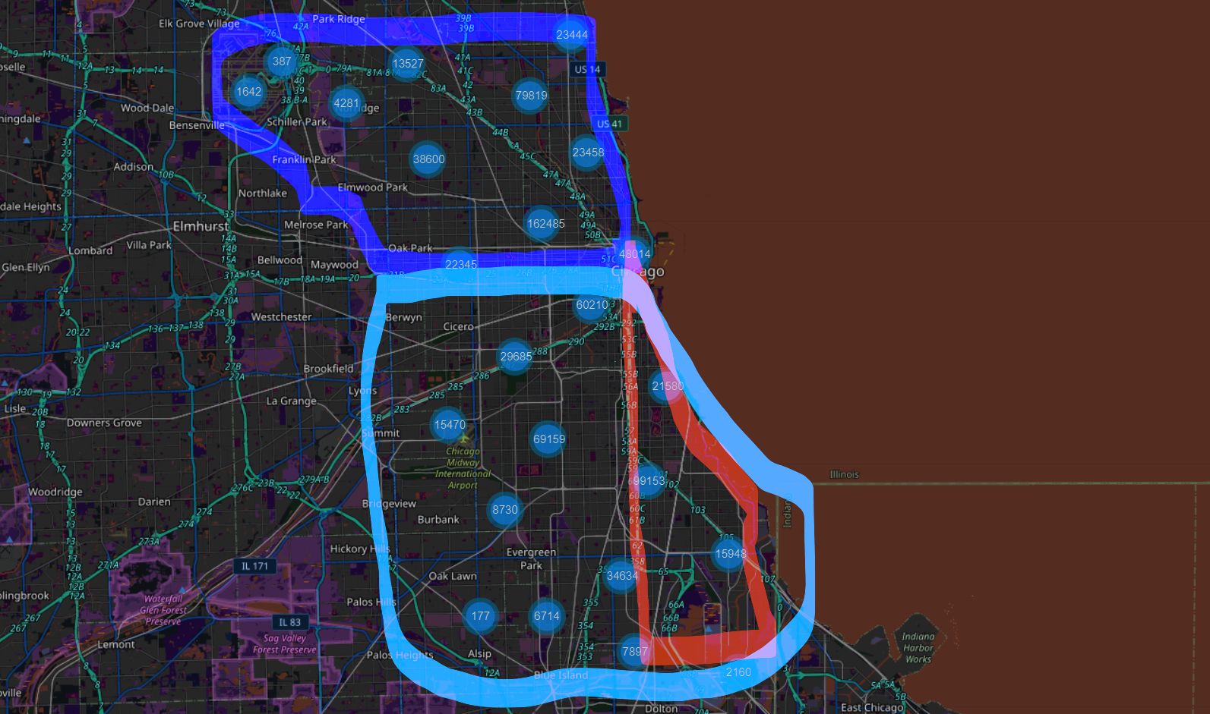
NORTH
[24.03%]
EAST
[6.84%]
SOUTH
[33.51%]

Slide 22
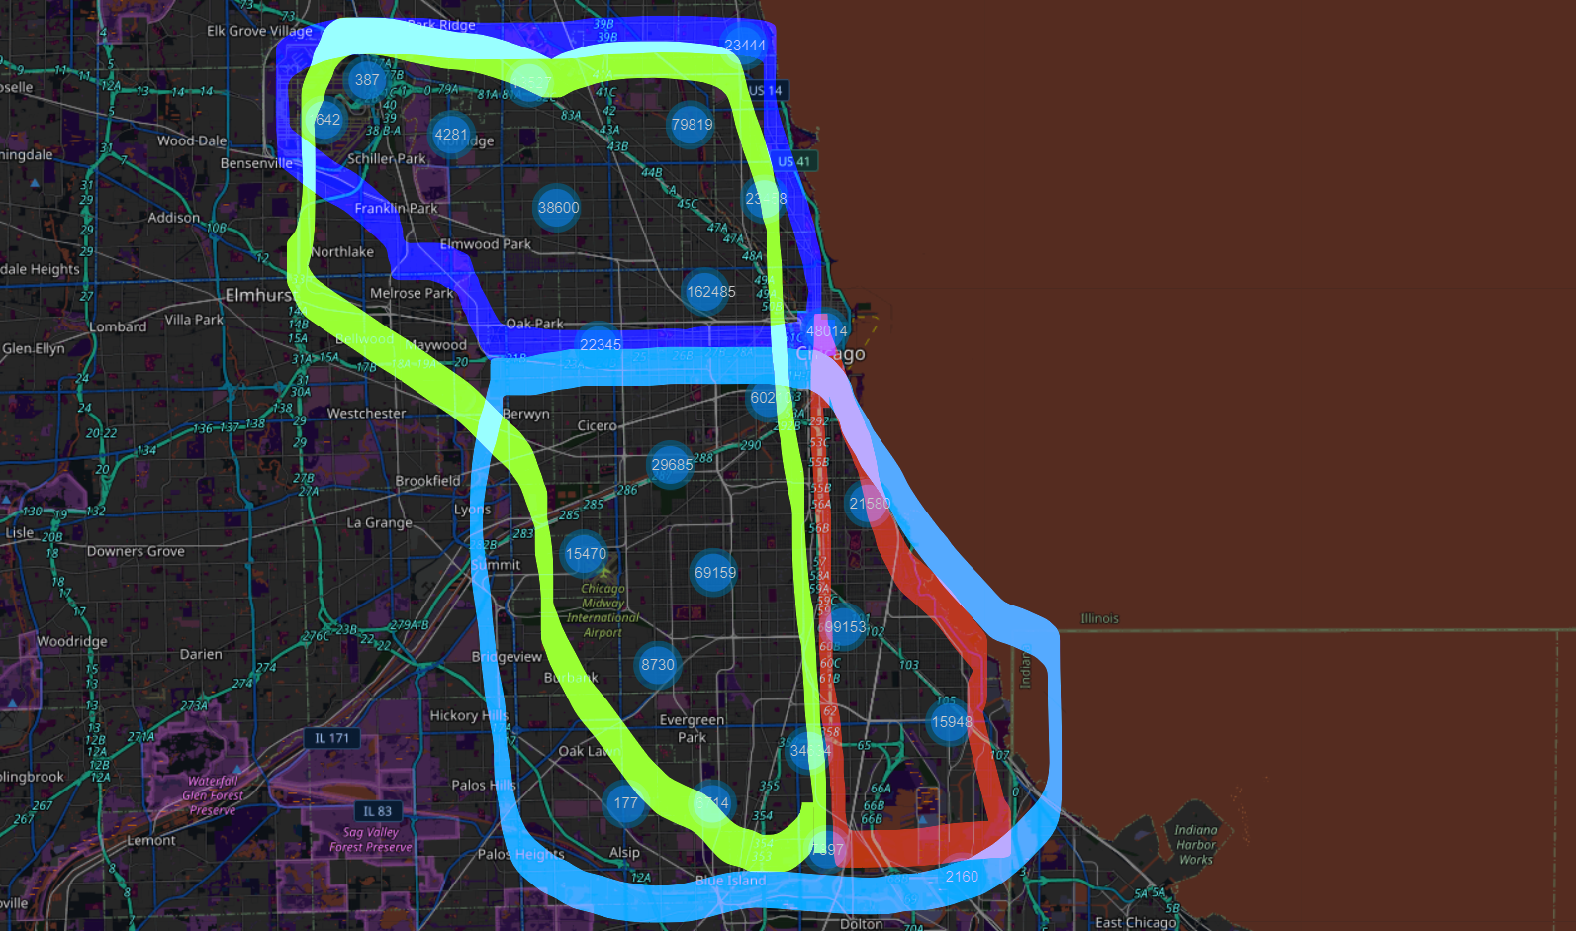
NORTH
[24.03%]
WEST
[35.62%]
EAST
[6.84%]
SOUTH
[33.51%]

Slide 23
Deciphering Traffic Crash Patterns
In summary, my analysis of traffic crash data reveals significant trends and patterns crucial for understanding road safety.
I observed fluctuations in crash rates over recent years, peaking in 2015 and 2021, with a decline during the onset of the pandemic in 2020.
Weekends, particularly Fridays to Sundays, see heightened crash activity, likely due to increased social gatherings and potential alcohol consumption.
Afternoons emerge as peak times for crashes, with fewer incidents post-midnight.
While most crashes report no injuries, a notable percentage indicate injuries without evident signs.
Primary contributors include failure to yield right-of-way and following too closely, alongside weather conditions.
Secondary factors like failing to reduce speed and improper turning also contribute significantly.
Infrastructure plays a role, with differing crash rates between undivided and divided roads.
Seasonal trends show more crashes in fall and summer, fewer in spring.
Geographically, crash occurrences vary, with fewer on the east side compared to the west and south.
Traffic control devices influence crash rates, and weather conditions impact crash occurrences.
Integrating these insights into our analysis will guide the development of targeted strategies to enhance road safety.

Slide 24
Learning Outcome
Successfully cleaned, transformed, and managed large and complex datasets comprising nearly 800K records and 48 attributes, ensuring data quality and integrity.
Proficient in building conditional DAX (Data Analysis Expressions) queries from the dataset, enabling customized and dynamic analysis.
Acquired knowledge in Azure SQL for establishing connections with Power BI, facilitating real-time data analysis and insights.
Demonstrated competence in utilizing the Power BI feature of syncing slicers across different pages, enhancing dashboard interactivity and user experience.
Capable of creating interactive dashboards featuring Key Performance Indicators (KPIs) and visually compelling graphics, enabling easy understanding and interpretation of data insights.

Slide 25
Thank You

